Slide 1
Credit Card Risks
By Suryansh Patel

Slide 2
Predicting Credit Risk
Introduction: One of the most important uses of data science in the financial sector is credit risk prediction. Machine learning is used by almost all lending institutions to predict credit risk.
Task: Create a model to predict the credit risks of various clients by looking at their income, debt levels, credit history, and other variables.

Slide 3
Importance of predicting Credit card risks?
Mitigates financial risks by identifying high-risk applicants.
Improves decision-making for credit approvals.
Ensures sustainable and profitable lending practices.
Role of Data Science:
Uses machine learning algorithms for risk analysis and prediction.
Processes large datasets to uncover hidden patterns and insights.
Develops robust models for real-time decision-making.

Slide 4
Main Goals of Project
Classify credit card applicants into risk categories
Minimize default rates and financial losses
Improve decision-making for credit approval

Slide 5
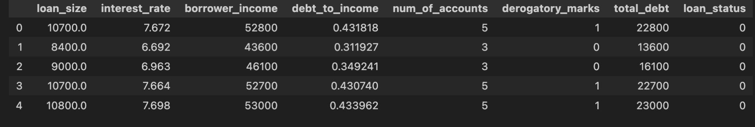
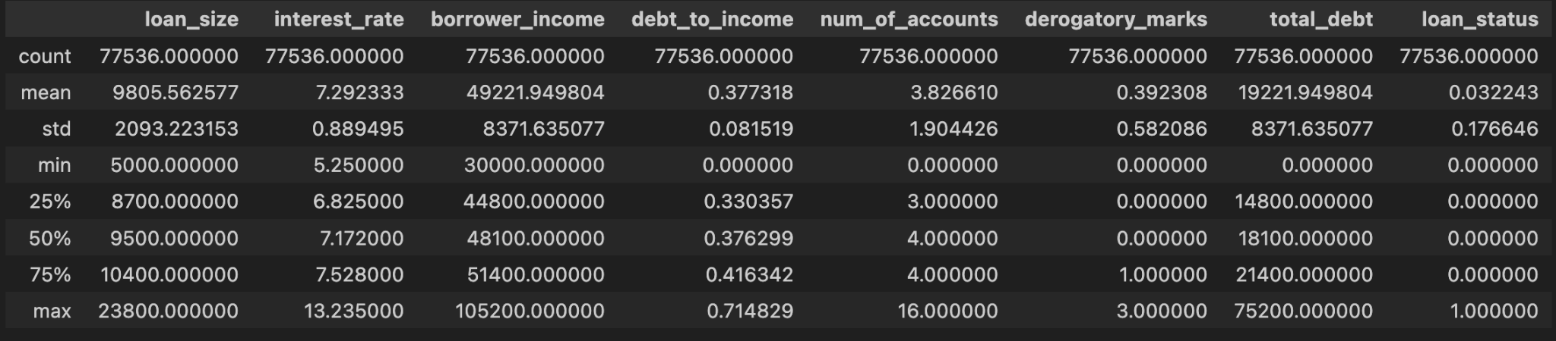
Data Description

Slide 6
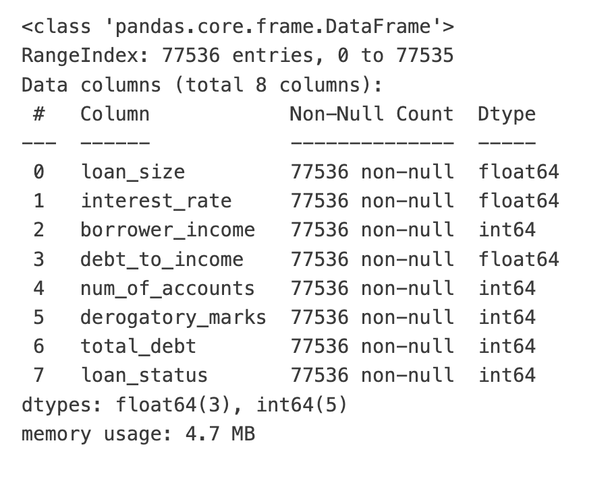
Data Description

Slide 7
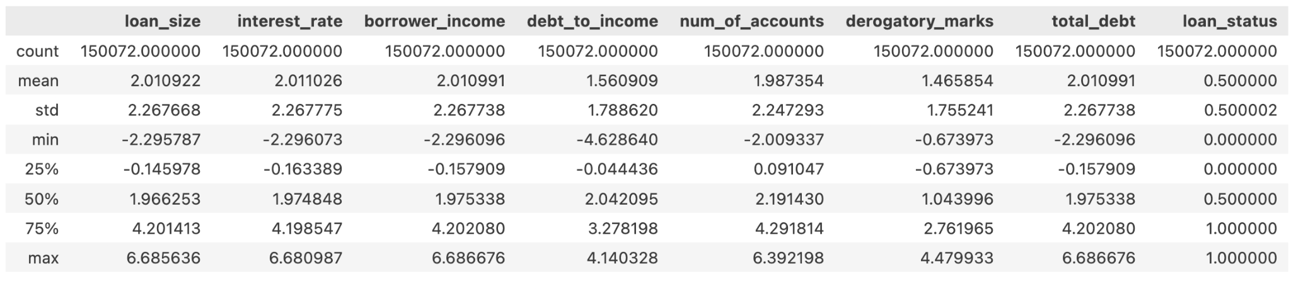
Data Preprocessing Steps
Check for Null values.
Check for outliers.
Data Scaling using Standard Scaler.
Over Sampling the minority class using SMOTE

Slide 8
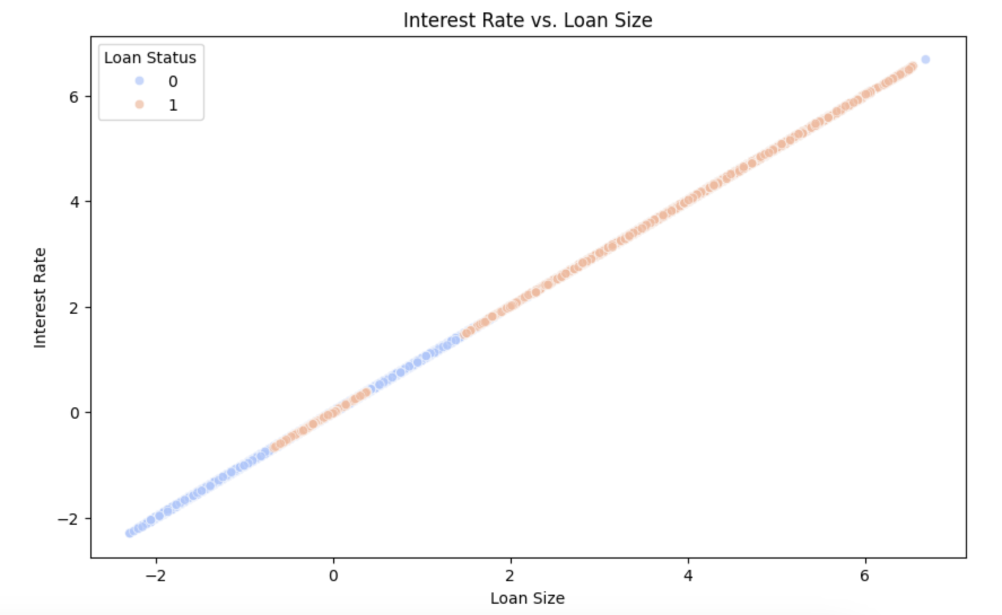
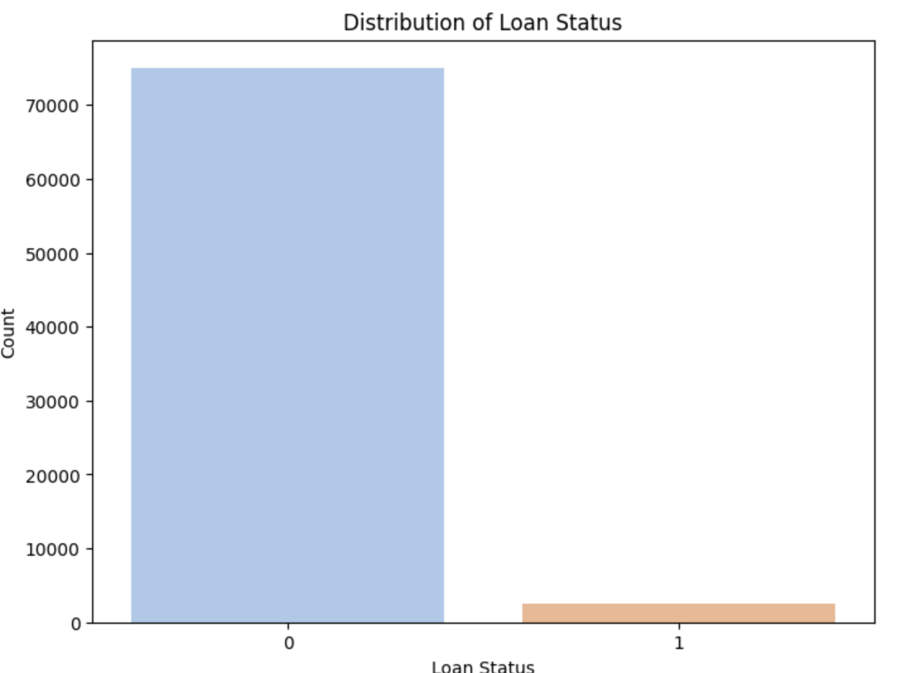
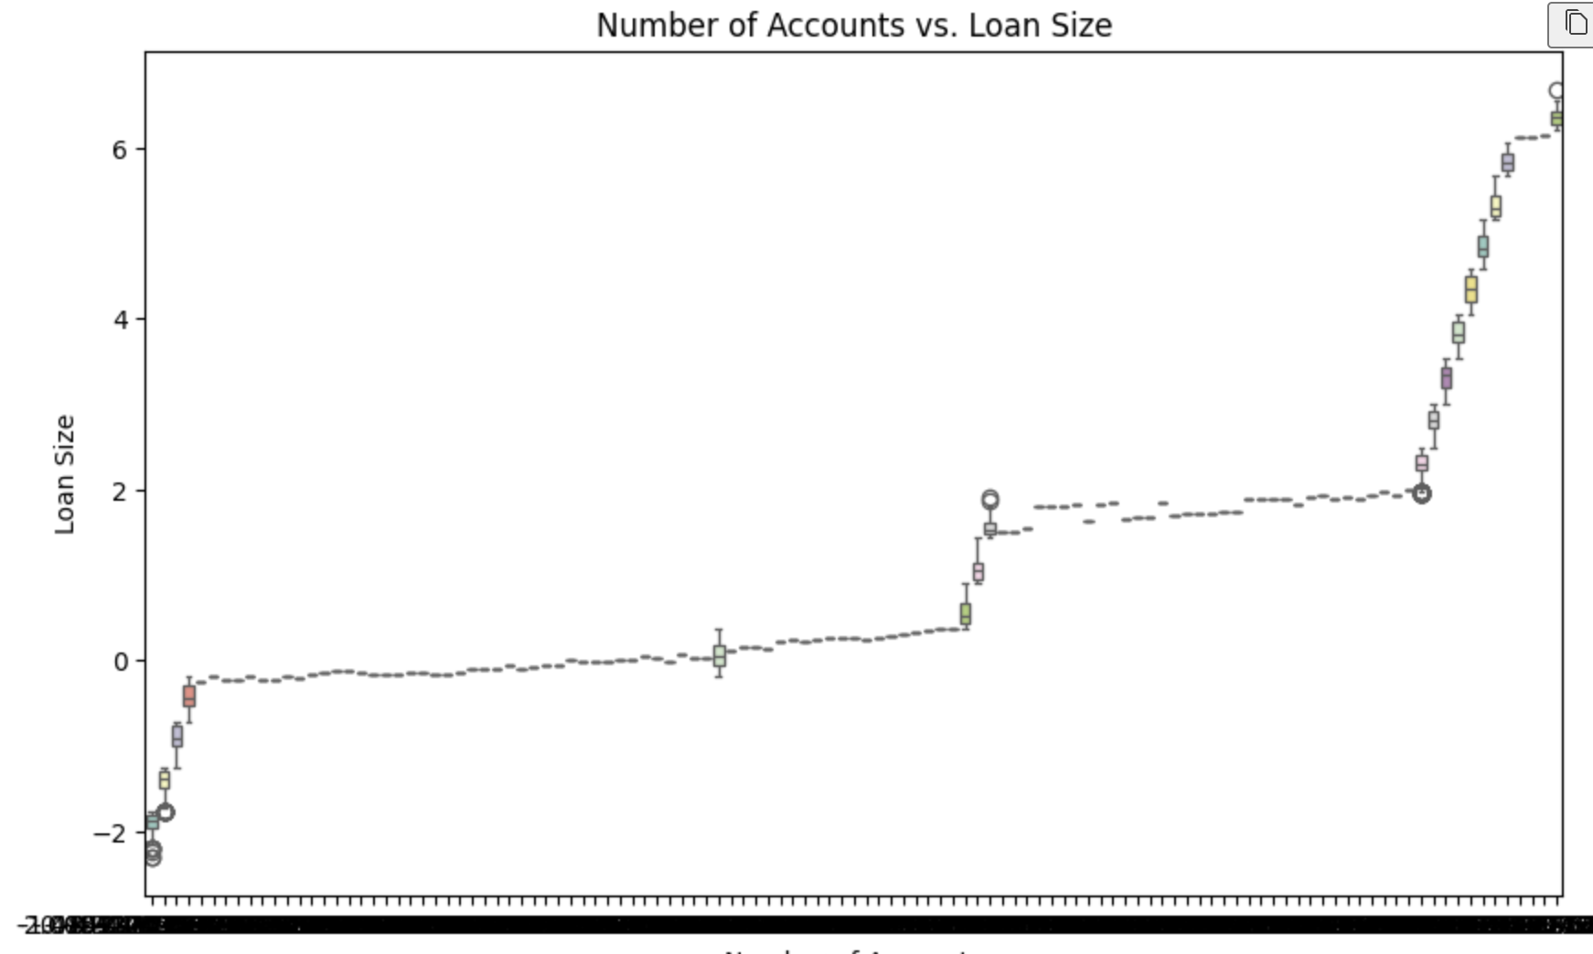
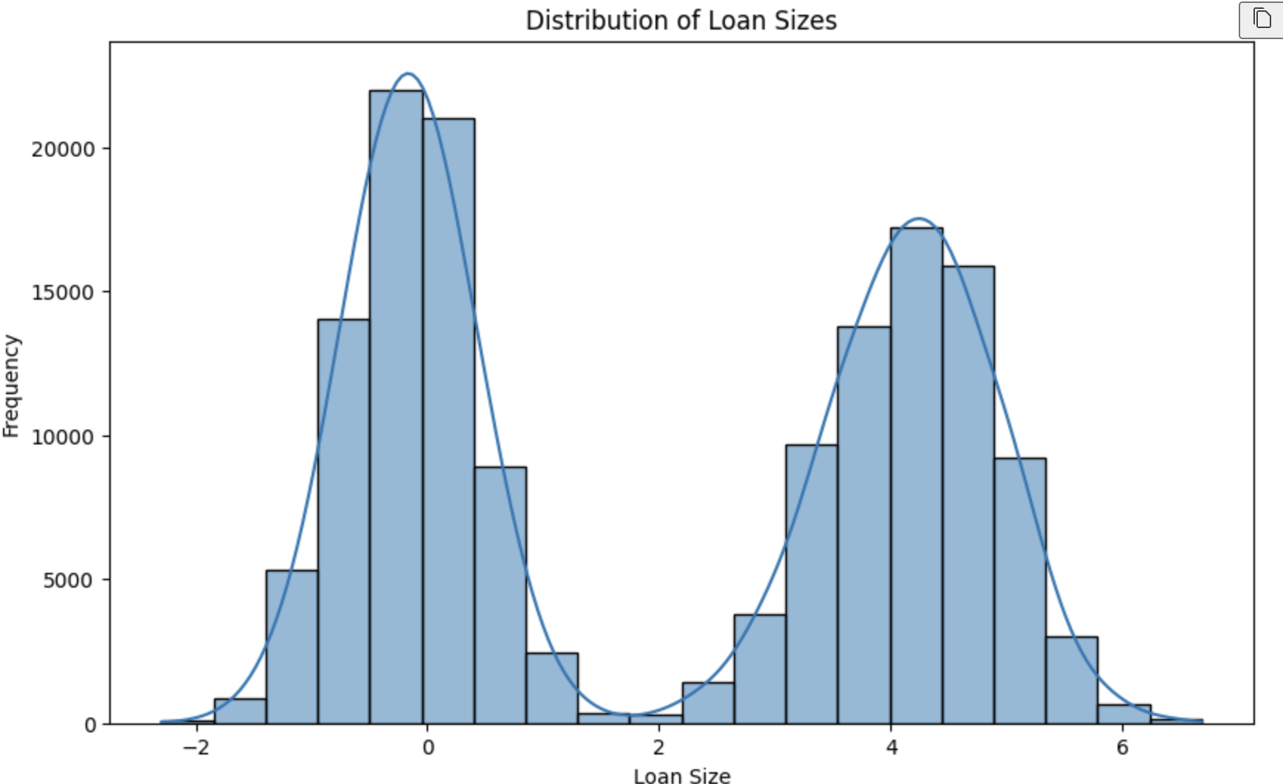
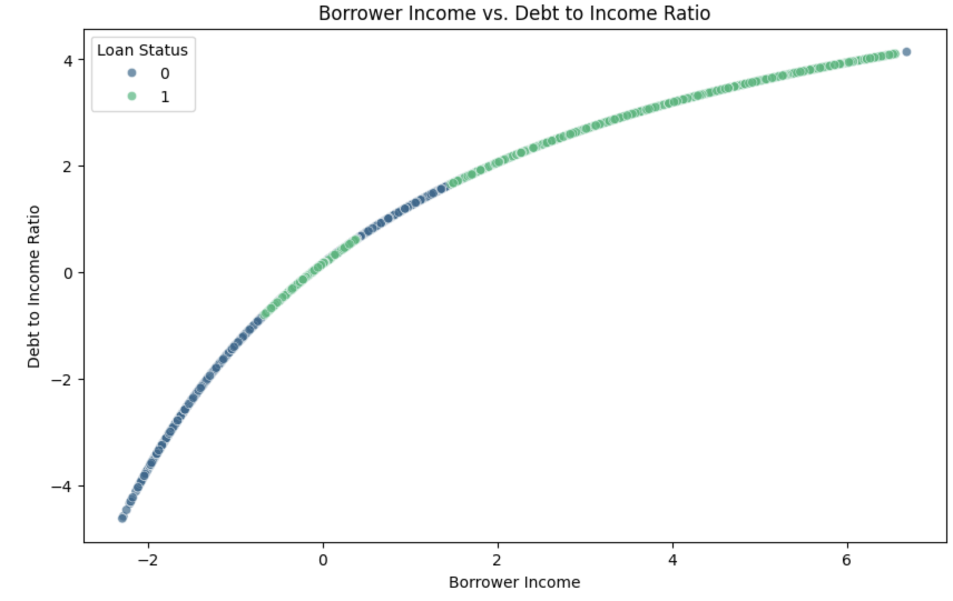
Visualizations?

Slide 9
Model Selection:
Logistic Regression:
Rationale:
Well-known standard for binary classification.
Provides a clear understanding of the relationship between features and the target variable.
Interpretable coefficients that indicate feature importance.
K-Nearest Neighbors (KNN):
Rationale:
Selected for its lazy training feature.
Unique approach of looking at data during prediction rather than during training.
Effective for datasets where similar instances have close proximity.

Slide 10
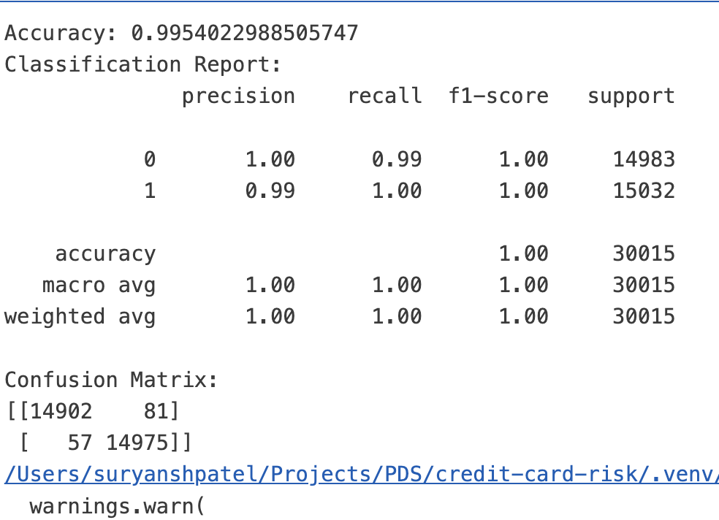
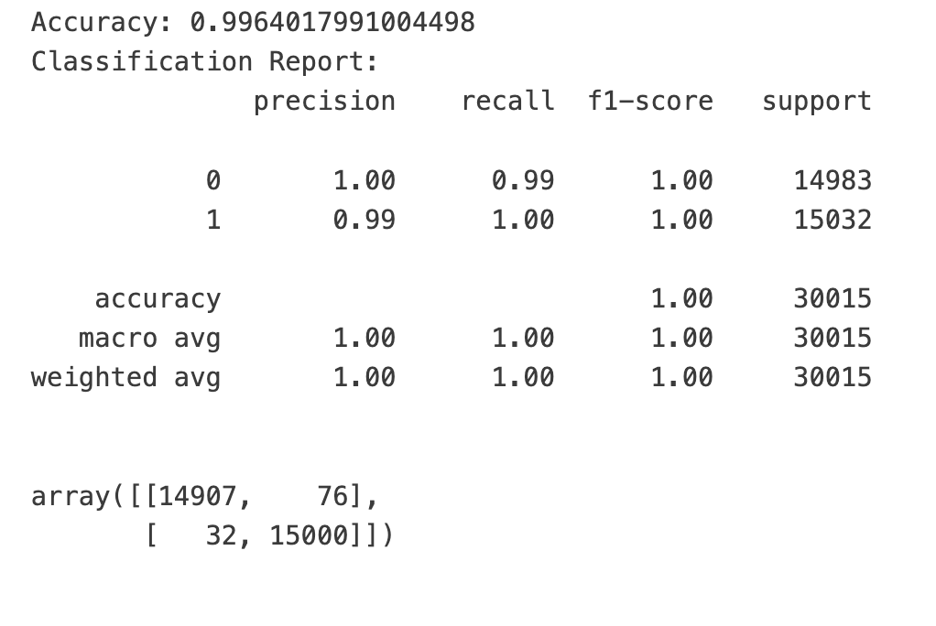

Slide 11
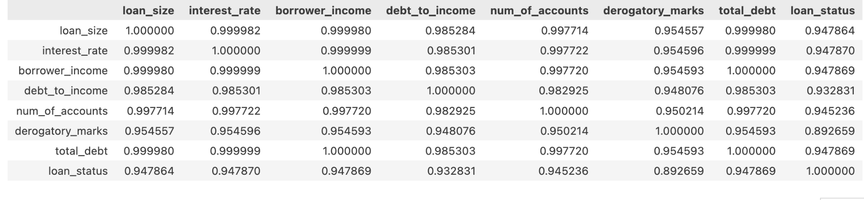
Correlation matrix

